Slide 1
Random Graphs - I
MA 653: Network Science
Instructor: Ashok Singh Sairam
ashok@iitg.ac.in

Slide 2
Network Models
In the last lecture, we looked at the degree distribution, etc. of real networks
Found that the centrality measure distribution of many networks follow the power law
We want to have formal processes which can give rise to networks with specific properties
E.g., degree distribution, largest component size, diameter, etc.
These models and their features can help us understand how the properties of a network (network structure) arise

Slide 3
Network Models (2)
Why network models?
Simple representation of complex networks
Predict properties and outcomes
By growing networks according to a variety of different rules/models and comparing the results with real networks, we can get a feel for which growth processes are plausible and which can be ruled out
Random graphs represent the “simplest” model

Slide 4
Random graphs
A random graph has some specific parameters fixed
In all other aspects, the network is random
The simplest example, we fix only the number of nodes and edges
We choose m pairs of the n vertices uniformly at random to connect them; typically we stipulate/demand simple graph
We refer to this random graph model as G(n,m)
We can also define the model by saying that the network is created by choosing uniformly at random a network among all sets of simple graphs with exactly n nodes and m edges

Slide 5
Random Graph:G(n,m) model
Strictly the model of random graph is not defined by one specific network instance
It is an ensemble/group of networks
A probability distribution over possible networks
Mathematically, G(n,m) is defined as a probability distribution P(G) over all graphs G
P(G)=1/Ω, where Ω is the number of simple graphs with exactly m edges and n nodes
In other words, we do not want to see what happens in a given network metric at a specific instance, but rather what is its probability distribution over the ensemble G(m,n)

Slide 6
Random Graph:G(n,m) model
For instance, the diameter of G(n,m), would be the diameter of a graph G, averaged over the ensemble:
This approach is in general convenient
Lends itself well to analytical calculation
We can see the typical properties of the network model we consider
The distribution of many network metrics, at the limit of large n, is sharply peaked around the mean value
Hence in the limit of large n we expect to see behaviors very close to the mean of the ensemble

Slide 7
Random Graph:G(n,p) model
For the G(n,m) model some properties are easy to compute
Average number of edges: m
Mean node degree: <k>=2m/n
However, other properties are hard to analytically obtain
We will use a slightly different model, G(n,p)
The number of nodes n is fixed
Furthermore, we fix the probability p, that is, place an edge between each distinct pair with independent probability p
Note: the number of edges in this network is not fixed

Slide 8
The G(n,p) model
G(n,p) is the ensemble of all networks with n vertices in which each network G appears with probability
m is the number of edges in G
What is the probability of selecting a graph with m edges?
G(n,p) is also referred in the literature as “Erdos-Renyi random graph”, “Poisson random graph”, “Bernoulli random graph” etc.

Slide 9
The G(n,p) model: Mean number of edges
Every edge has a probability p of being part of the network
There are in total possible edges
Edges appear in the graph independently
Hence mean value for m is p

Slide 10
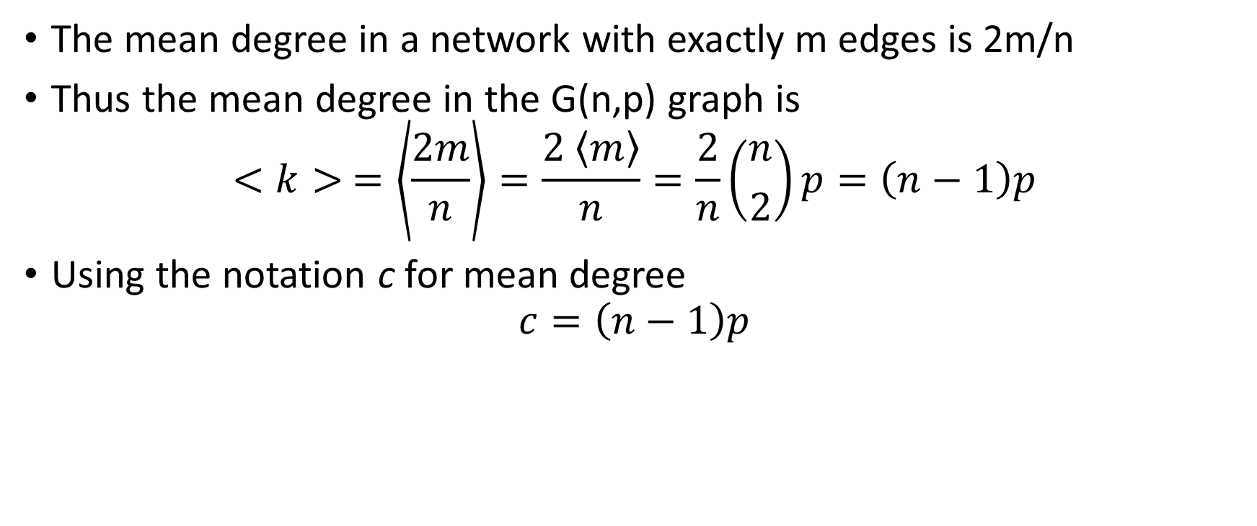
Mean degree
The mean degree in a network with exactly m edges is 2m/n
Thus the mean degree in the G(n,p) graph is
$$<k> =\left\langle \frac{2m}{n}\right\rangle =\frac{2 \left\langle m\right\rangle }{n}=\frac{2}{n}\left({n \atop 2}\right)p=\left(n−1\right)p$$
Using the notation c for mean degree
$$c=\left(n−1\right)p$$

Slide 11
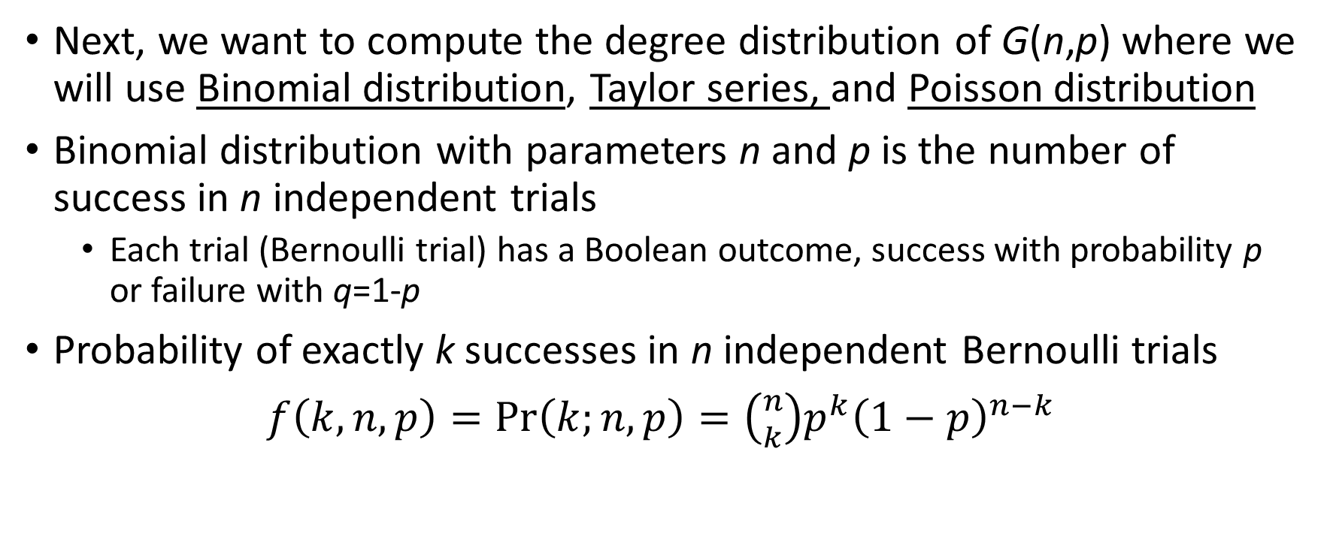
Review: Binomial Distribution
Next, we want to compute the degree distribution of G(n,p) where we will use Binomial distribution, Taylor series, and Poisson distribution
Binomial distribution with parameters n and p is the number of success in n independent trials
Each trial (Bernoulli trial) has a Boolean outcome, success with probability p or failure with q=1-p
Probability of exactly k successes in n independent Bernoulli trials
$f\left(k,n,p\right)=\operatorname{Pr}\left(k;n,p\right)=\left({n \atop k}\right)p^{k}{\left(1−p\right)}^{n−k}$

Slide 12
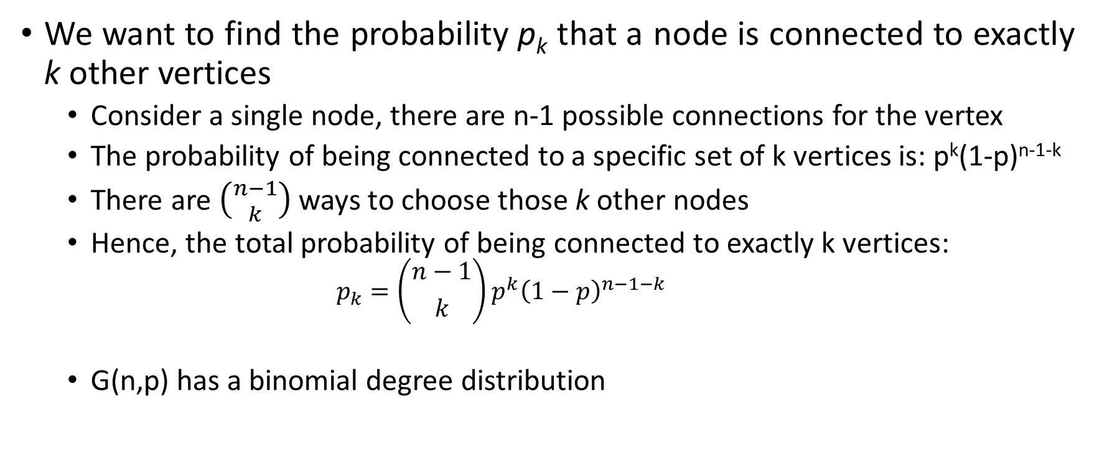
The G(n,p) model: Degree distribution
We want to find the probability p_{k} that a node is connected to exactly k other vertices
Consider a single node, there are n-1 possible connections for the vertex
The probability of being connected to a specific set of k vertices is: p^{k}(1-p)^{n-1-k}
There are $\left({n−1 \atop k}\right)$ ways to choose those k other nodes
Hence, the total probability of being connected to exactly k vertices:
$$p_{k}=\left({n−1 \atop k}\right)p^{k}{\left(1−p\right)}^{n−1−k}$$
G(n,p) has a binomial degree distribution

Slide 13
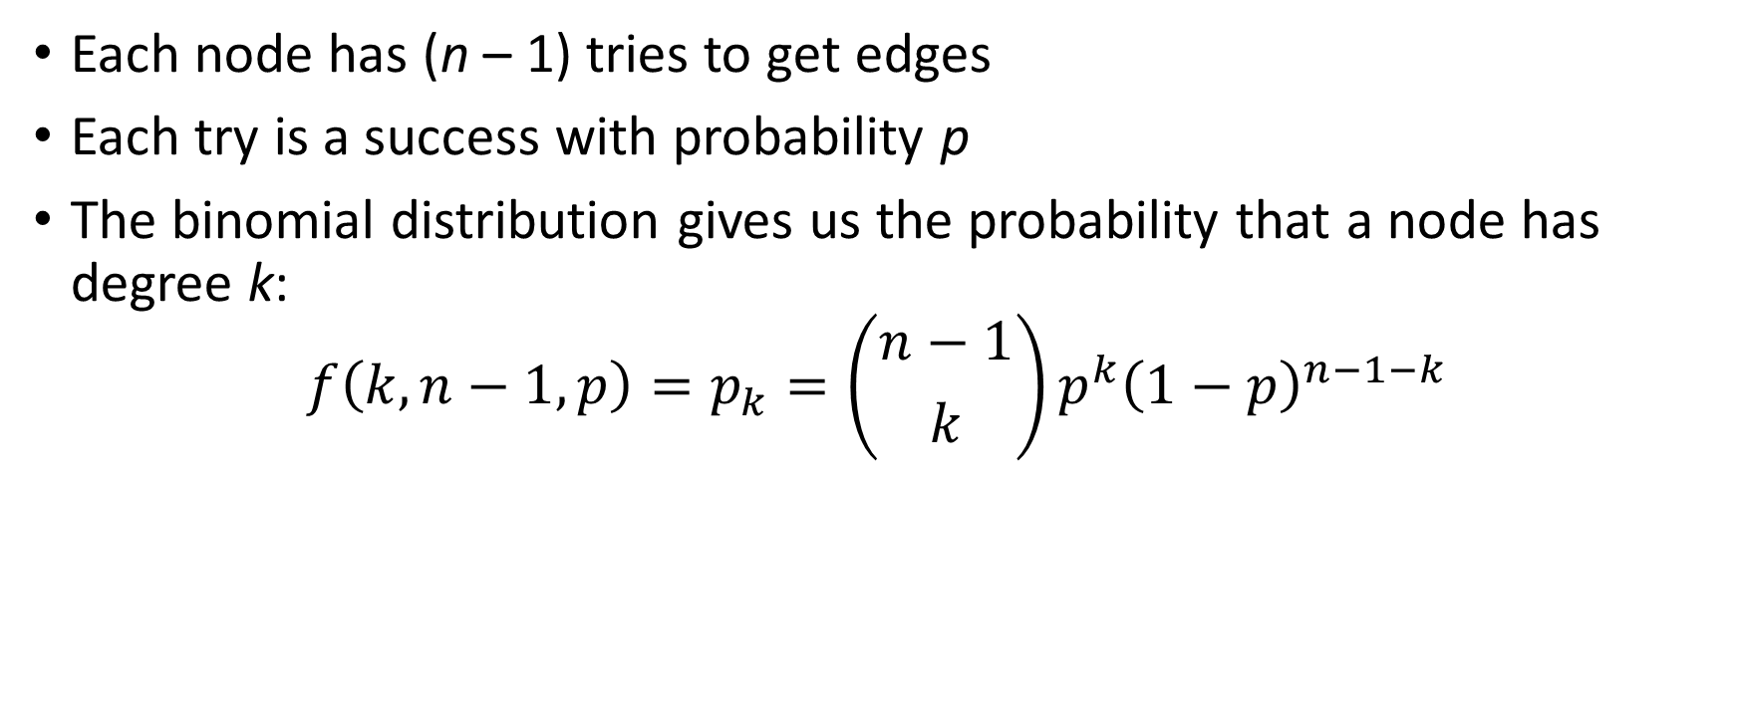
Binomial degree distribution
Each node has (n – 1) tries to get edges
Each try is a success with probability p
The binomial distribution gives us the probability that a node has degree k:
$$f\left(k,n−1,p\right)=p_{k}=\left({n−1 \atop k}\right)p^{k}{\left(1−p\right)}^{n−1−k}$$

Slide 14
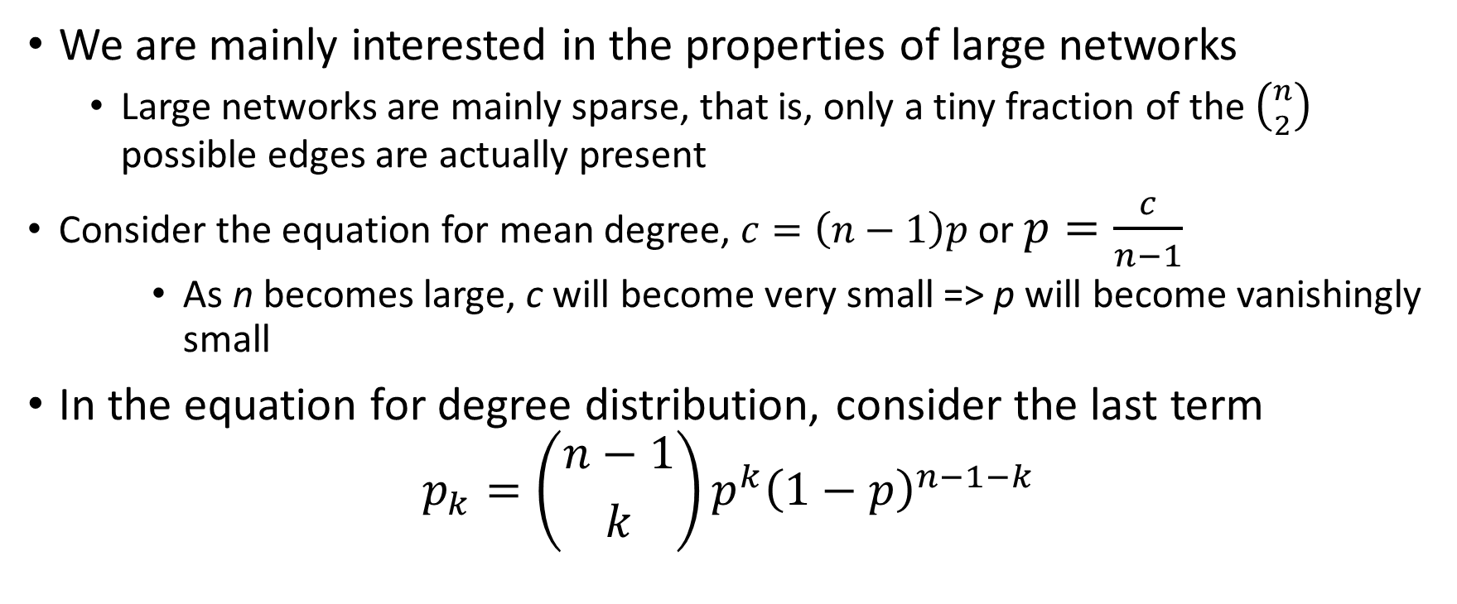
The G(n,p) model: Degree distribution (2)
We are mainly interested in the properties of large networks
Large networks are mainly sparse, that is, only a tiny fraction of the $\left({n \atop 2}\right)$ possible edges are actually present
Consider the equation for mean degree, $c=\left(n−1\right)p$ or $p=\frac{c}{n−1}$
As n becomes large, c will become very small => p will become vanishingly small
In the equation for degree distribution, consider the last term
$$p_{k}=\left({n−1 \atop k}\right)p^{k}{\left(1−p\right)}^{n−1−k}$$

Slide 15
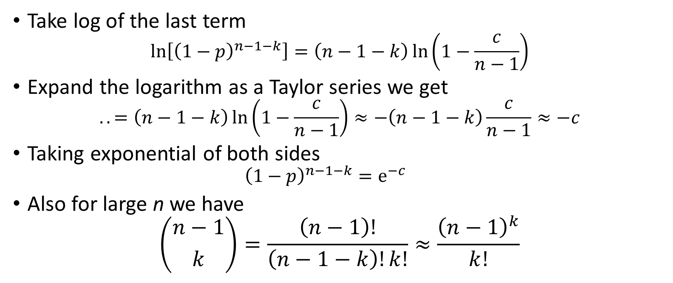
Take log of the last term
$$\ln\left[{\left(1−p\right)}^{n−1−k}\right]=\left(n−1−k\right)\ln\left(1−\frac{c}{n−1}\right)$$
Expand the logarithm as a Taylor series we get
$$..=\left(n−1−k\right)\ln\left(1−\frac{c}{n−1}\right)≈−\left(n−1−k\right)\frac{c}{n−1}≈−c$$
Taking exponential of both sides
$${\left(1−p\right)}^{n−1−k}=e^{−c}$$
Also for large n we have
$$\left({n−1 \atop k}\right)=\frac{\left(n−1\right)!}{\left(n−1−k\right)!k!}≈\frac{{\left(n−1\right)}^{k}}{k!}$$

Slide 16
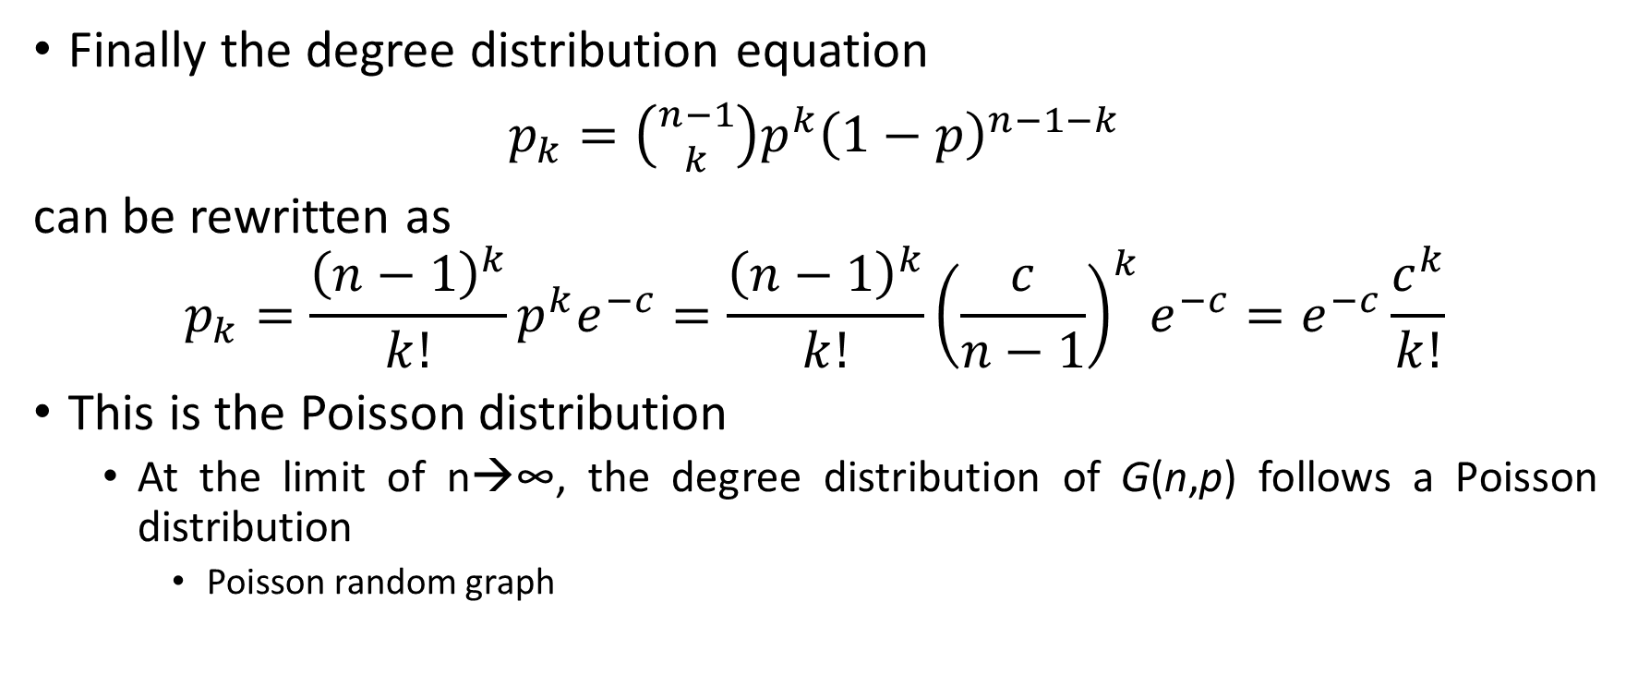
Finally the degree distribution equation
$p_{k}=\left({n−1 \atop k}\right)p^{k}{\left(1−p\right)}^{n−1−k}$
can be rewritten as
$$p_{k}=\frac{{\left(n−1\right)}^{k}}{k!}p^{k}e^{−c}=\frac{{\left(n−1\right)}^{k}}{k!}{\left(\frac{c}{n−1}\right)}^{k}e^{−c}=e^{−c}\frac{c^{k}}{k!}$$
This is the Poisson distribution
At the limit of n→∞, the degree distribution of G(n,p) follows a Poisson distribution
Poisson random graph

Slide 17
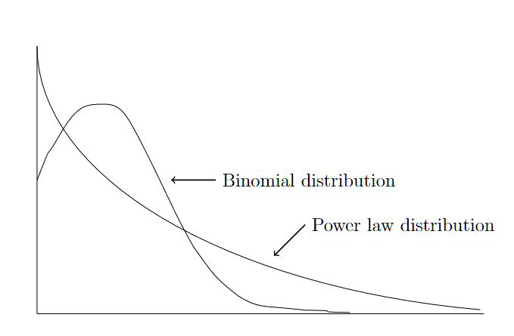

Slide 18
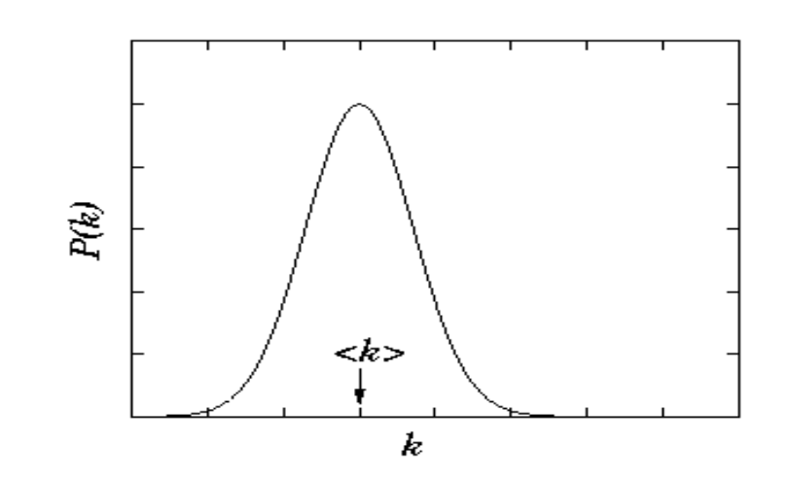
Poisson Distribution
A Poisson distribution is a discrete probability distribution.
Gives probability of an event happening a certain number of times (k) within a given interval of time or space.
The Poisson distribution has only one parameter, λ (lambda), which is the mean number events

Slide 19

Approximations
Binomial
$p_{k}=\left({n−1 \atop k}\right)p^{k}{\left(1−p\right)}^{n−1−k}$
${ { p}_{k}=e}^{−c}\frac{c^{k}}{k!}$
limit p small, or, n -> infinity
Poisson

Slide 20
Clustering Coefficient
Clustering coefficient is defined as the probability that two vertices with a common neighbor are connected themselves
In a random graph the probability that any two vertices are connected is equal to p=c/(n-1)
Hence the clustering coefficient is also:
Given that for large n, c is constant, it follows that the clustering coefficient goes to 0
This is a sharp difference between the G(n,p) model and real networks

Slide 21

Summary: G(n,p) model
Construct a G(n,p) network
Start with n isolated nodes
For a particular node pair (u,v), generate a random number r. If $r≤p$, then add the link (u,v) to the network
Repeat Step 2 for each of the $\left({n \atop 2}\right)$ node pairs

Slide 22
Recap
Consider a random network generated according to the G(n, p) model where n = 12 and p = 0.20. Determine the following:
The probability that there are exactly 60 edges in the network = ((nC2)C60) *p^(60)*((1-p)^((nC2)-60))
The average number of edges in the network (nC2)p
The average node degree (n-1)*p
The probability that a node has exactly 5 neighbours (Hint: use degree distribution) p5 ,i.e., using degree distribution
The average local clustering coefficient for any node in the network. p
The expected local clustering coefficient for a node that has exactly 5 neighbors. = p

Slide 23

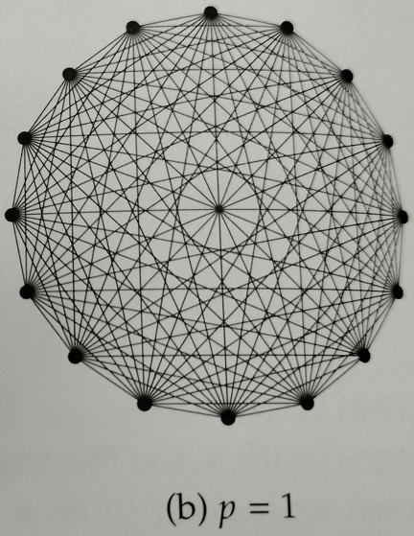
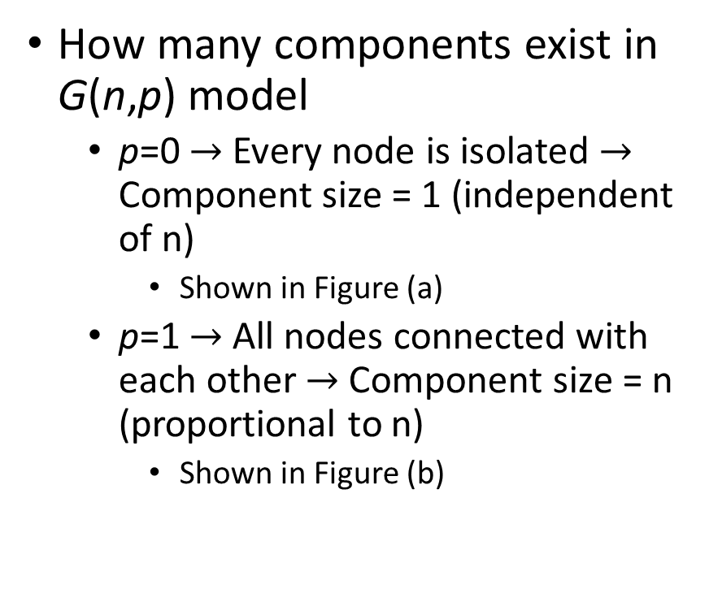
Components in the G(n,p) model
How many components exist in G(n,p) model
p=0 $→$ Every node is isolated $→$ Component size = 1 (independent of n)
Shown in Figure (a)
p=1 $→$ All nodes connected with each other $→$Component size = n (proportional to n)
Shown in Figure (b)

Slide 24
How does component size vary?
It is interesting to examine what happens for values of p in-between 0 and 1
In particular, what happens to the largest component in the network as p increases?
The size of the largest component undergoes a sudden change, or phase transition, from constant size to extensive size at one particular special value of p
A network component whose size grows in proportion to n is called giant component

Slide 25
Giant Component
Let u be the fraction of nodes that do not belong to the giant component. Hence,
If there is no giant component → u=1
If there is giant component → u<1
In order for a node i not to connect to the giant component:
i is not connected to any other node j → 1-p
i is connected to j, but j itself is not connected to the giant component → pu
u is the probability that node j doesn’t belong to the giant component

Slide 26
Giant Component: Equation
Hence, the total probability of i not being connected to giant component via vertex j is: 1-p+pu
Considering all n-1 vertices through which i can connect:
Taking the logarithms at both sides and the Taylor approximation for large n:
This equation cannot be solved in close form

Slide 27
Graphical solution of Giant component
We plot y=1-e^{-cS} with S between 0 and 1 (since it can take values between this range only)
We also plot y=S
The point where the two curves intersect
is the solution
For small c only one solution at S=0
No giant component
For greater c there might be two
solutions (at S=0 and S>0)
In this regime there can be a giant component

Slide 28
Graphical solution of Giant component
The middle curve corresponds to the transition between the two regimes
Transition between the two curves happens at c=1
Until now we have proved that if c≤1 there cannot be any giant component
However, we have not proved what happens if c>1
How can we be sure that there is a giant component?
After all there are two solutions to the equation

Slide 29
Condition for giant component
Find a small connected set of nodes
Core (dark region) set of nodes with connection only inside the set
Periphery (lighter region) is the set of nodes that have at least one neighbour outside the core
Grow the set by adding the neighbours of the periphery
Old periphery becomes core and new periphery is the recently added nodes
The periphery of this initially small
component can only increase if c>1

Slide 30
Condition for giant component
Expected size of the new periphery is c times the old periphery
Thus if c> 1 the average size of the periphery will grow exponentially
We expect a giant component iff c > 1

Slide 31
Exercise
Ex 11.4. Consider the random graph G(n,p) with n large.
If the network has a giant component that fills exactly half of the network, what is the average degree of a node? => Given, S=1/2. Calculate c from the formula
For this same random graph what is the probability that a node has degree exactly 5? => calculate p5 (using poission degree distribution)
What is the probability that a node belongs to the giant component if it has degree exactly 5? => (1-u)^5
Hence or otherwise, calculate the fraction of nodes in the giant component that have degree exactly 5. => P(5|GC) (not sure)

